Slide 1

Preparing to study the surface of Phobos using IDEFIX WheelCam Images
MASTER in AEROSPACE ENGINEERING
Research Project
Florian Mellab and Paloma Tejero Aranguren
Supervisors:
Dr. Naomi Murdoch
Alice Amsili

Slide 2
INDEX
Introduction
Theoretical Background
Methodology
Results and discussion
Conclusions and future work

Slide 3
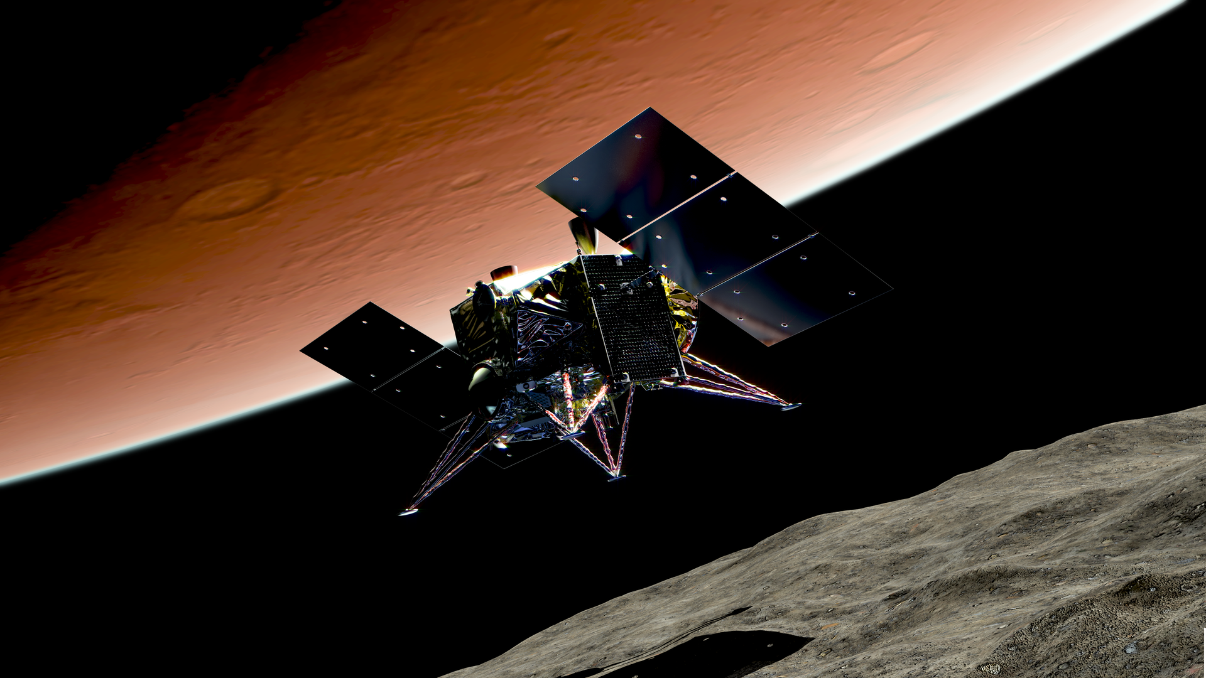
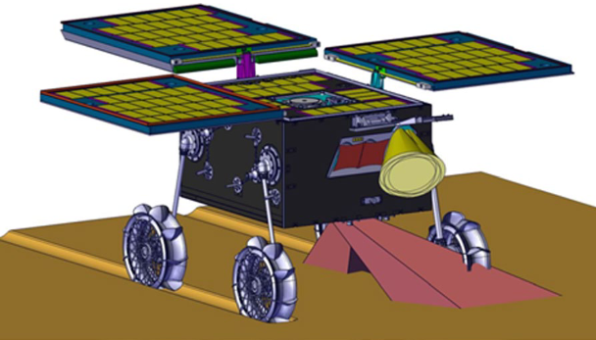
INTRODUCTION
Notes:
INTRODUCTION:
MMX – 2026 – JAXA
Phobos and Deimos – Sample return mission
Unknown surface – landing risk
IDEFIX – in situ

Slide 4

INTRODUCTION
Notes:
INTRODUCTION:
This is IDEFIX
Intruments: navcams, wheelcams, raman spectrometer and miniature radiometer
Wheelcams and LED (7)
Field of view – wheel moves
Interaction
Properties -- + LED – composition

Slide 5
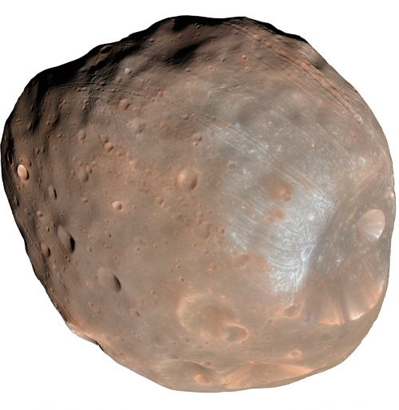
INTRODUCTION
OBJECTIVES
Develop an algorithm that can isolate the wheel and estimate the sinkage
Determine how the combination of the colored LEDs and the panchromatic camera can provide information about the surface of Phobos.
Notes:
INTRODUCTION:
Big objectives such as the origin of the moons
More conservative

Slide 6
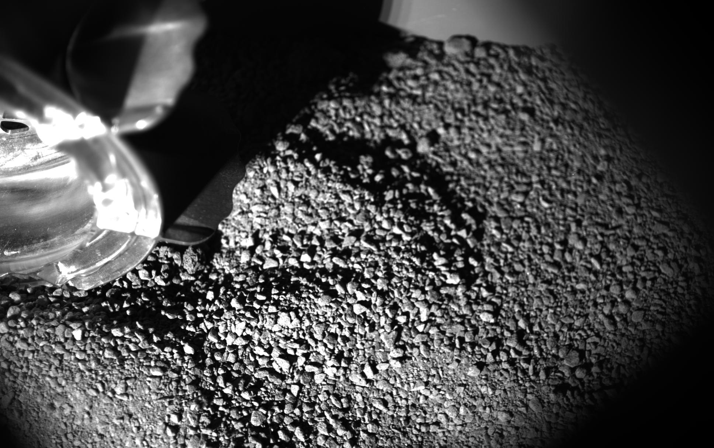
THEORETICAL BACKGROUND
Bearing capacity
Cohesion
Friction
Wheel sinkage
Spectral signature
Reflectance
Notes:
General context for what we are trying to do
Goal is to perform science with WheelCam images
Contribute to understanding of composition of regolith on Phobos
Sinkage
First route explored is sinkage
Together with wheel slip analysis constrain mechanical properties
Influence on driving capability and main spacecraft landing dynamics
Spectral analysis
Second issue is to perform spectral analysis with WheelCam images
Problem: only get black/white images from panchromatic camera
Analyse brightness
brightness proportional to reflectance.
Illuminate regolith in narrow wavelength using the colored LEDs.
Identify spectral signatures from brightness only
Compare to known spectral curves.
Recognize materials

Slide 7
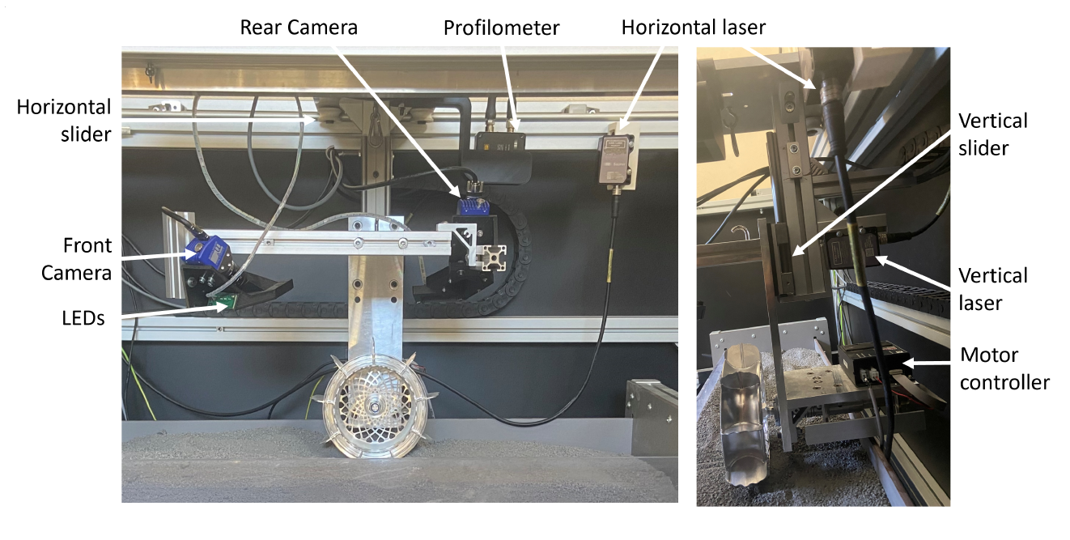
METHODOLOGY
EXPERIMENTAL TESTBED
Notes:
Why they built it
Develop image processing tools
Simulate different environments
Uncertainty on Phobos: remote images
Tools must work with all conditions
How we have/will use it
Part of the methodology for our research.
Sinkage part:
validation test set: vertical LASER ground truth
both cameras (front and rear)
Different regolith type (size, texture, reflectance), sinkage level
Spectral analysis part:
Experiments conducted using the colored LEDs
Understand wether useful spectral information about the regolith can be extracted from panchromatic WheelCam images.

Slide 8
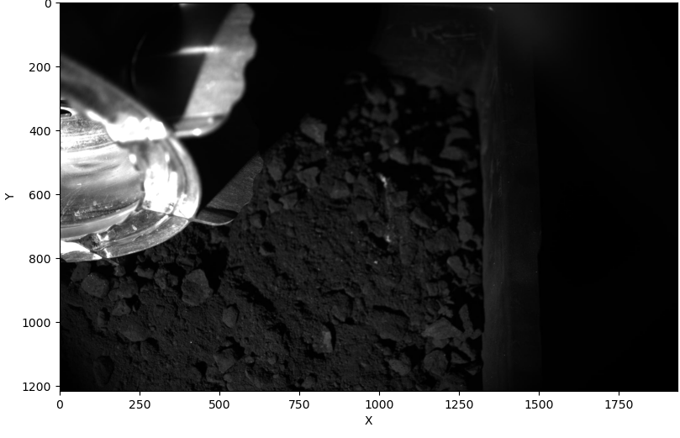
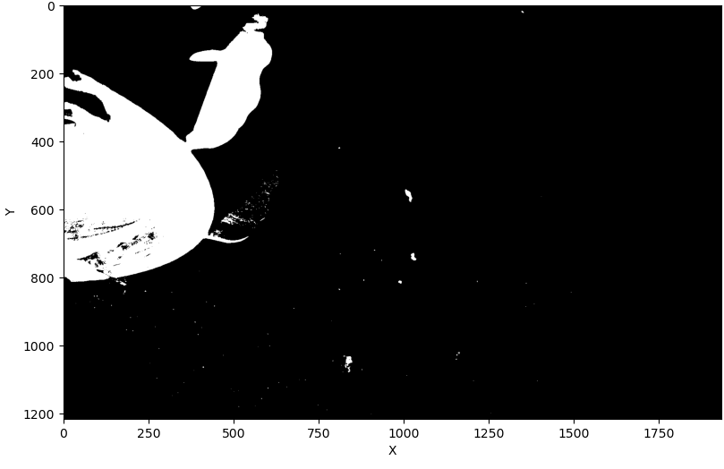
METHODOLOGY
WHEEL SINKAGE
Why classical CV over ML?
Interpretability of results
Data requirement
Robustness
Segmentation
Notes:
ML vs. classical CV
Work in this domain by previous students
Developed ML model
Did not reach desired performance
Now decided to switch to CV
Interpretability of results: understand and follow what the algorithm does at each step
Data requirement: labeled training data time consuming
Robustness: quickly change model parameters to adapt to changing environment
Segmentation
First step: binary segmentation
Wheel confidence area
Average value
Adaptive bounds: bounds tuning

Slide 9
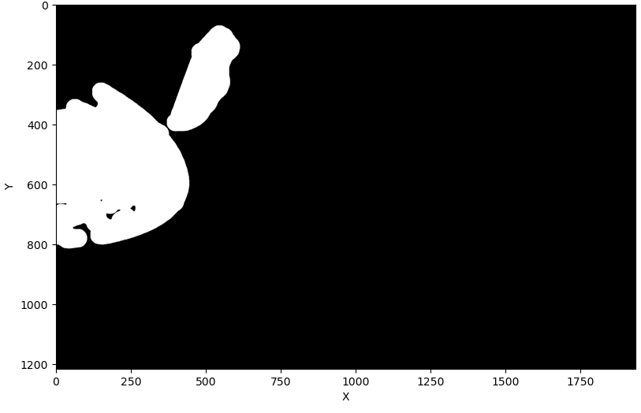
METHODOLOGY
WHEEL SINKAGE
Morphological transformations
cv2.MORPH_OPEN
cv2.MORPH_CLOSE
Notes:
Morphological transformations
Want to improve quality of mask
Remove protrusions and fill holes
Closing operation followed by opening
May look like we are losing information but important result: separated grouser from main wheel

Slide 10
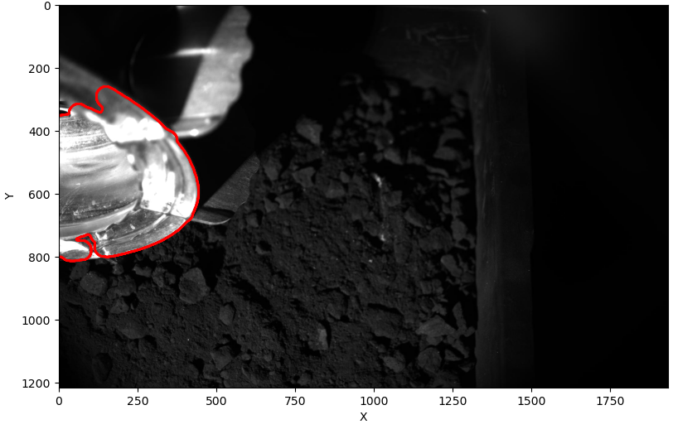
METHODOLOGY
WHEEL SINKAGE
Edge detection and contour selection
cv2.GaussianBlur()
cv2.Canny()
cv2.findContours()
cv2.minEnclosingCircle()
Notes:
Edge detection and contour selection
Edges of the mask should be detected
Gaussian blurr + Canny edge detection
Edge map
Problem: find many useless edges
Filter to find contour corresponding to main object
minEnclosingCircle function and select contour with largest radius

Slide 11
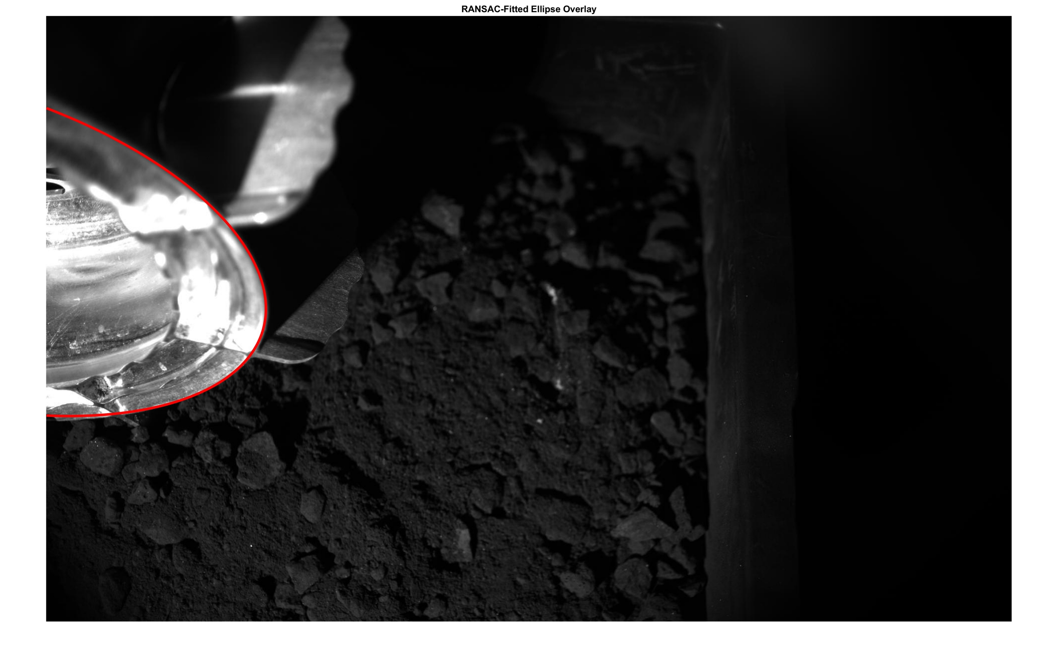
METHODOLOGY
WHEEL SINKAGE
RANSAC ellipse fit
Notes:
RANSAC based ellipse fitting
Contour not perfect and does not follow the entire wheel
ellipse vs. other conic sections due to camera angle (perspective)
Want to find the ellipse model that best fits the points on the wheel edge.
A RANSAC (Random Sampling) algorithm to deal with noise in a robust way.

Slide 12
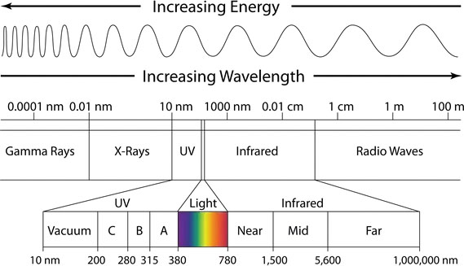
METHODOLOGY
SPECTROMETRY
LED1
LED2
LED3
Notes:
Wheelcams 550-900
Panchromatic – join signals – grayscale
Distinguishing – not posible
LED – narrow spectral wavelength
Environment response
First time this is researched
3 LEDs – point

Slide 13
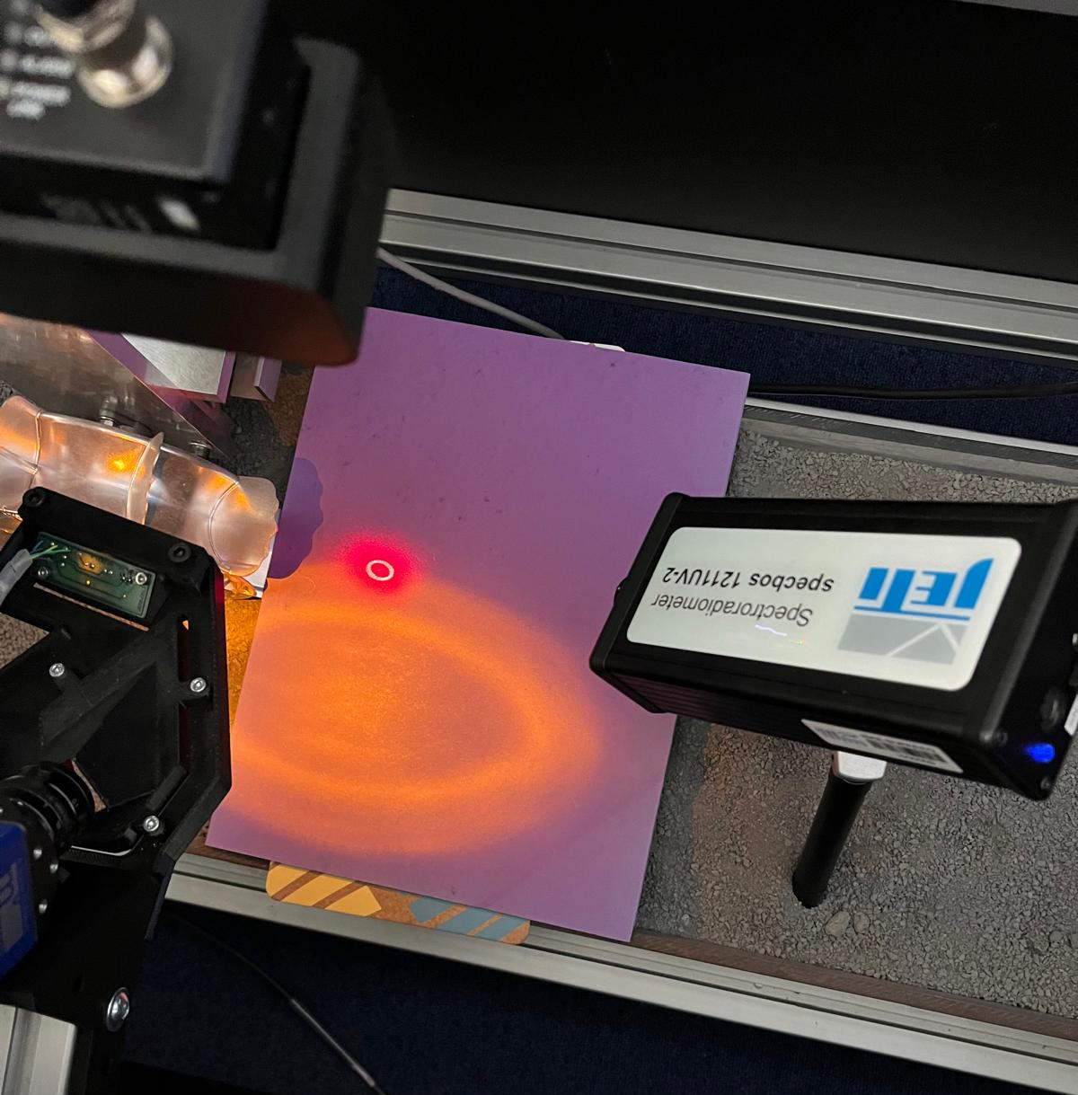
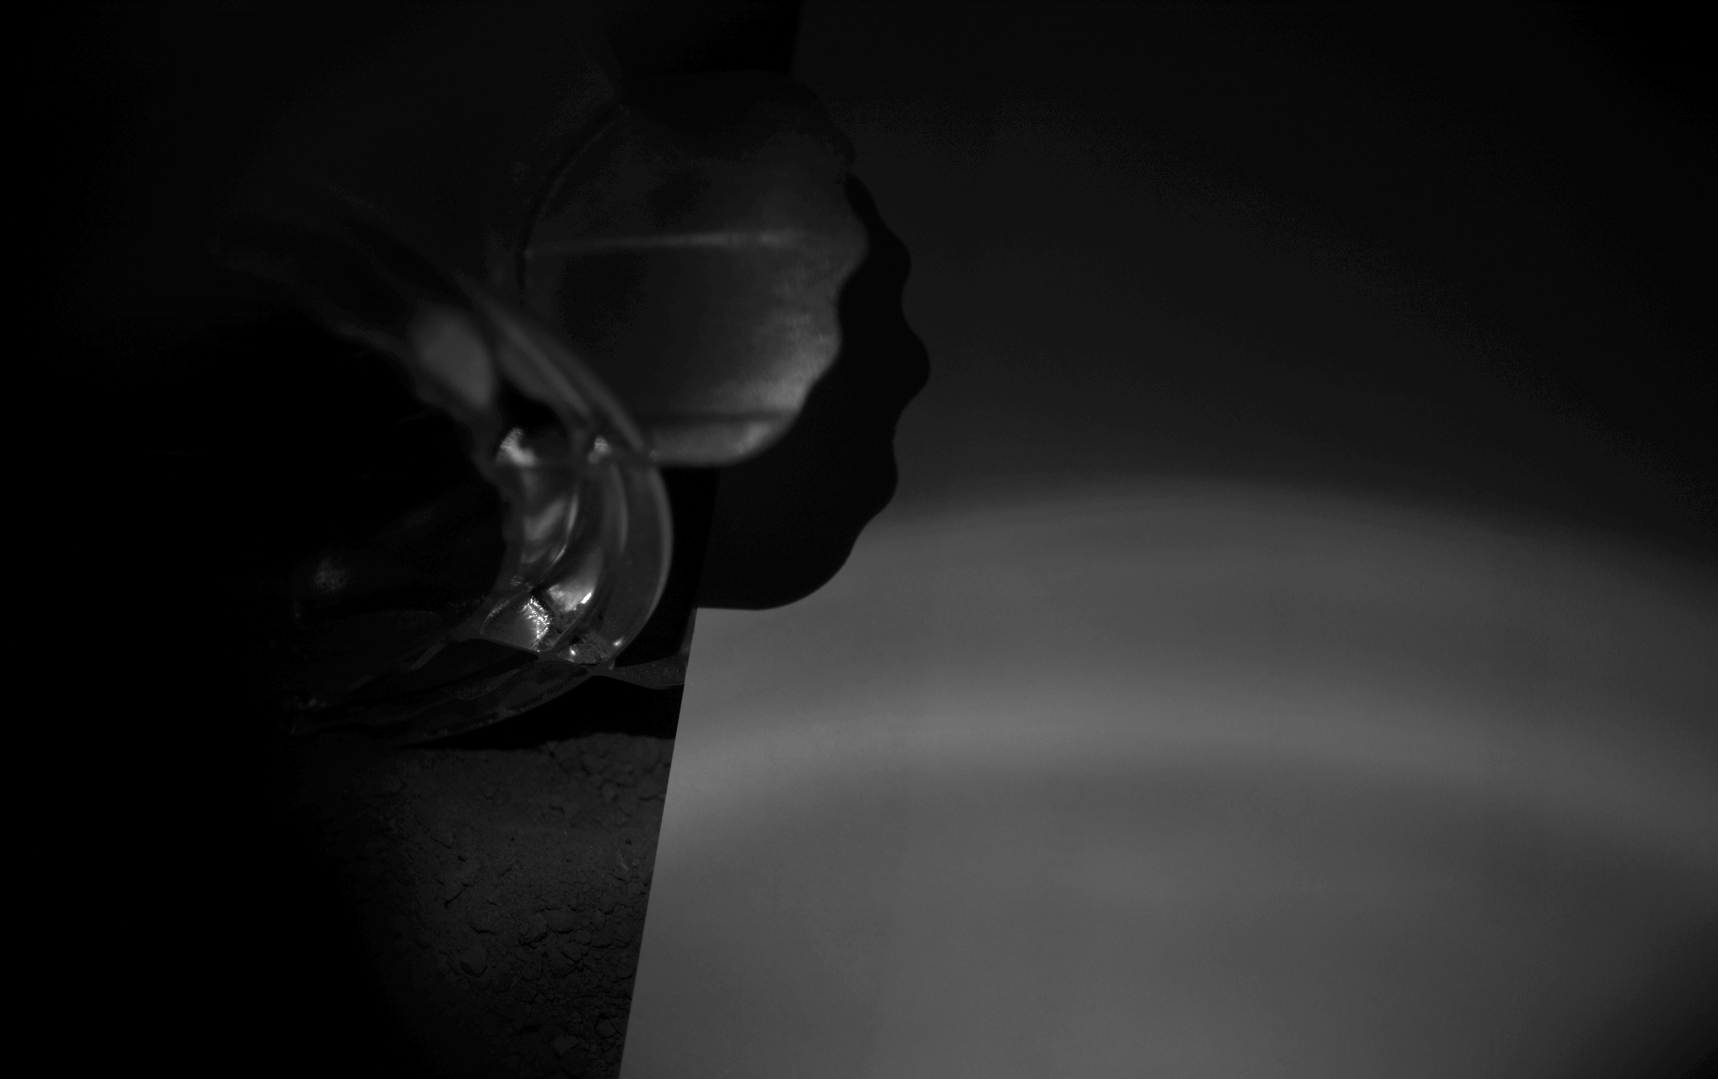
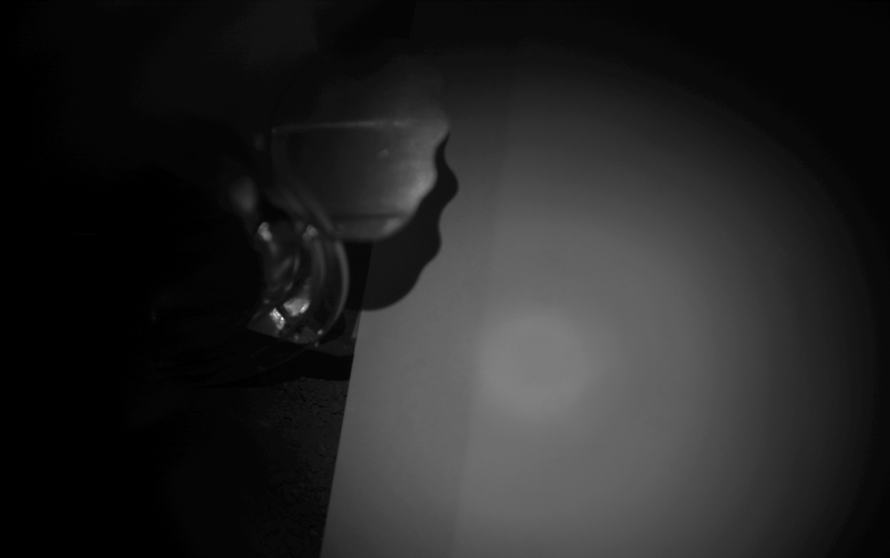
METHODOLOGY
SPECTROMETRY
Spectrometer Laser
LED1 (590nm Yellow)
LED2 (720 nm Red)
LED3 (880 nm IR)
Notes:
Goal materials – simplified
Colors
Confirm values with the spectrometer
Describe the set up
Mention shape and point
Mention intensities

Slide 14
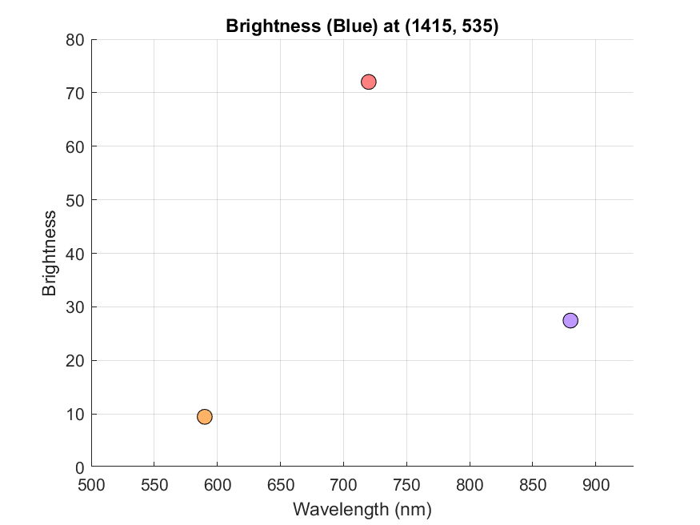
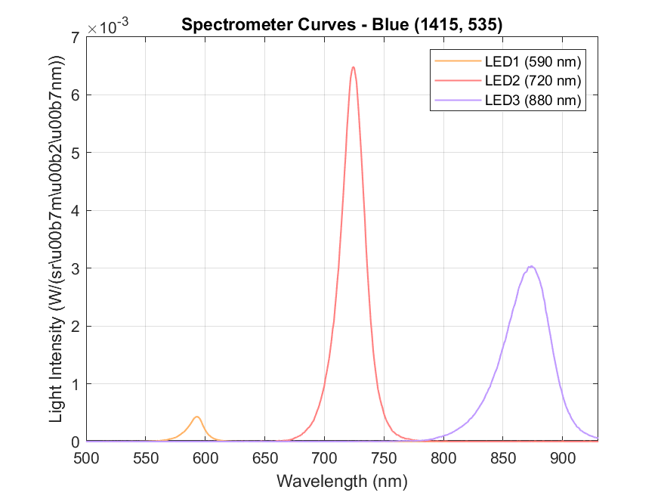
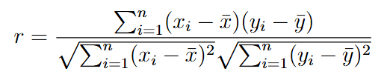
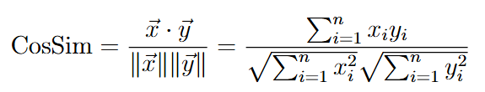
METHODOLOGY
SPECTROMETRY
PEARSON CORRELATION
COSINE SIMILARITY
Notes:
Talk about the images
Comparison: pearson and cosine
Complementary

Slide 15
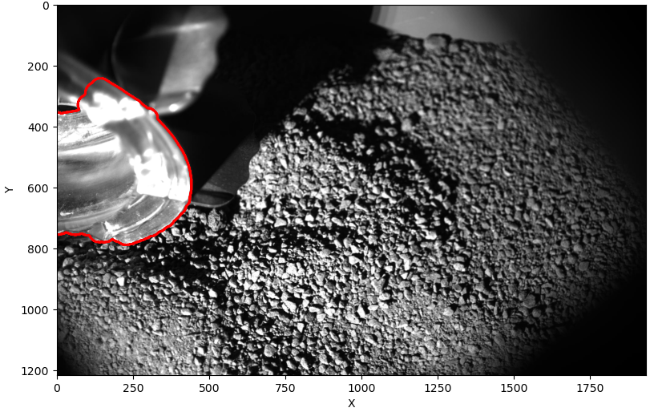
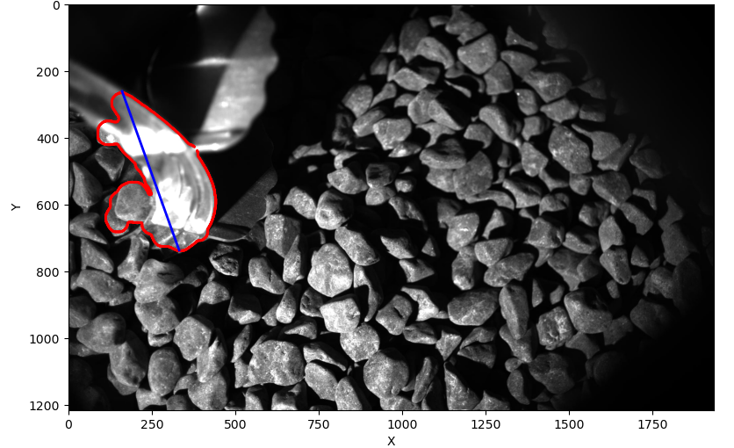
RESULTS
WHEEL SINKAGE
Moon simulant, low sinkage
Coarse gravel, high sinkage
Good quality contour
Stable ellipse fit
Good contour tracking but many outliers
Processing of contour required before ellipse fit
Notes:
Rear wheel cam
First test: Moon regolith, higher reflectance, low sinkage
Stress test: Coarse gravel, high reflectance, high sinkage
In both cases, able to detect edge with minimal adjustement of model parameters (wheel confidence area and kernel size).
In the gravel case, more processing was required before RANSAC to give a stable fit: the contour had to be cleaned to remove some noisy points.

Slide 16
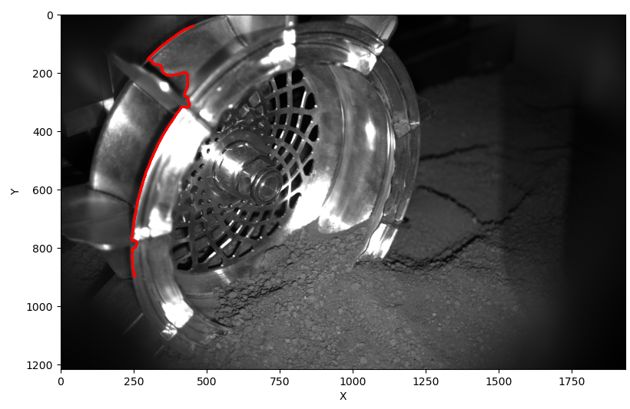
RESULTS
WHEEL SINKAGE
Issues with front WheelCam
Detection on one side
Unstable ellipse fit
May require a custom algorithm
Notes:
Front wheel cam
Developed for rear wheel cam
would be nice also to work on front wheelcam
More information: clear wheel/regolith interface
Precise and accurate contour tracking
Issues we are facing: detection on one side

Slide 17
RESULTS
SPECTROMETRY
Notes:
Spectra – White LEDs – all papers
Optical characteristics
Relative indication of light reflected
Highlights – spectral regions – most light reflected
Essential to understand results
Signal to noise ratio
Dark blue dark green
Cameras sensitivity

Slide 18
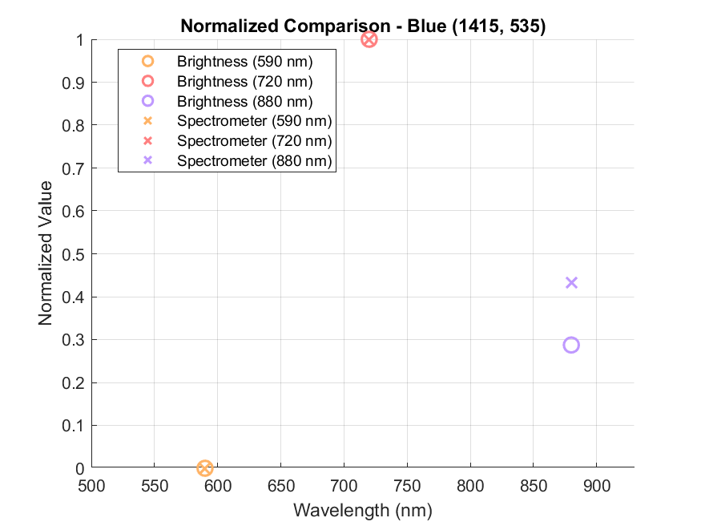
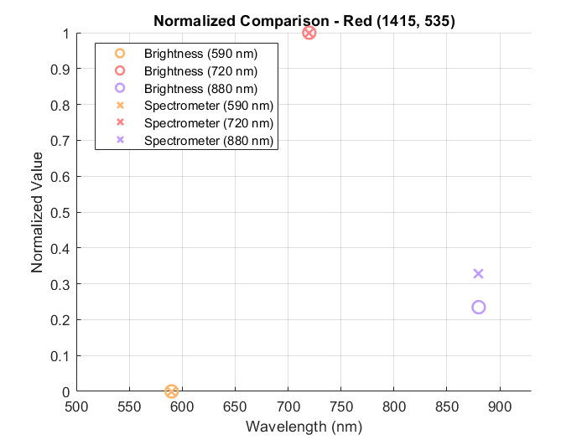
RESULTS
SPECTROMETRY
PEARSON CORRELATION > 0.98
COSINE SIMILARITY > 0.99
Notes:
Normalized visual comparison
Talk about results – blue + green

Slide 19
RESULTS
SPECTROMETRY
Reverse recognition: comparing the brightness of one paper to all the spectrometer measurements and finding the correct color.
Notes:
Reverse recognition: def
No magnitudes – just trends
All trends similar – point it out
Diff between brightness and spectrometer

Slide 20
CONCLUSIONS
WHEEL DETECTION
SPECTROMETRY
Good performance of wheel detection algorithm in different conditions
Algorithm is not optimized for the front WheelCam images
Simplified model – effective initial step
Obtaining trend similarity from brightness – possible
Assumptions made must be corrected as complexity increases
Reverse recognition is limited
Notes:
Paloma. Conclusions
Brightness seems to a valid proxy for reflectance trends under controlled conditions
The simplified colored paper model was an effect initial step
The infrared LED introduces limitations in our correlations, since the camera is not very sensitive at this wavelength. Spectral sensitivity and calibrations assumptions will be corrected and improved
For this mode, reverse recognition is limited do to the similarity of the trends of the papers. Paloma. Future Work
Expanding for real materials
Computing actual values of reflectance using a calibrating panel
Sensitivity of the camera****
Florian Conclusions
Florian Future Work
We have an outline of the next steps to implement in the processing pipeline. The ellipse will need to transformed back into a circle using a homography transform, as if the camera observed the wheel perpendicularly. Then, the wheel/regolith interface should be detected. This is where the regolith surface line intersects the homography (it will be clearer in the next images I will show where the wheel is sunk into the regolith). Finally, we can calculate the sinkage as a proportion of the wheel radius by measuring the distance from wheel center to regolith interface.

Slide 21
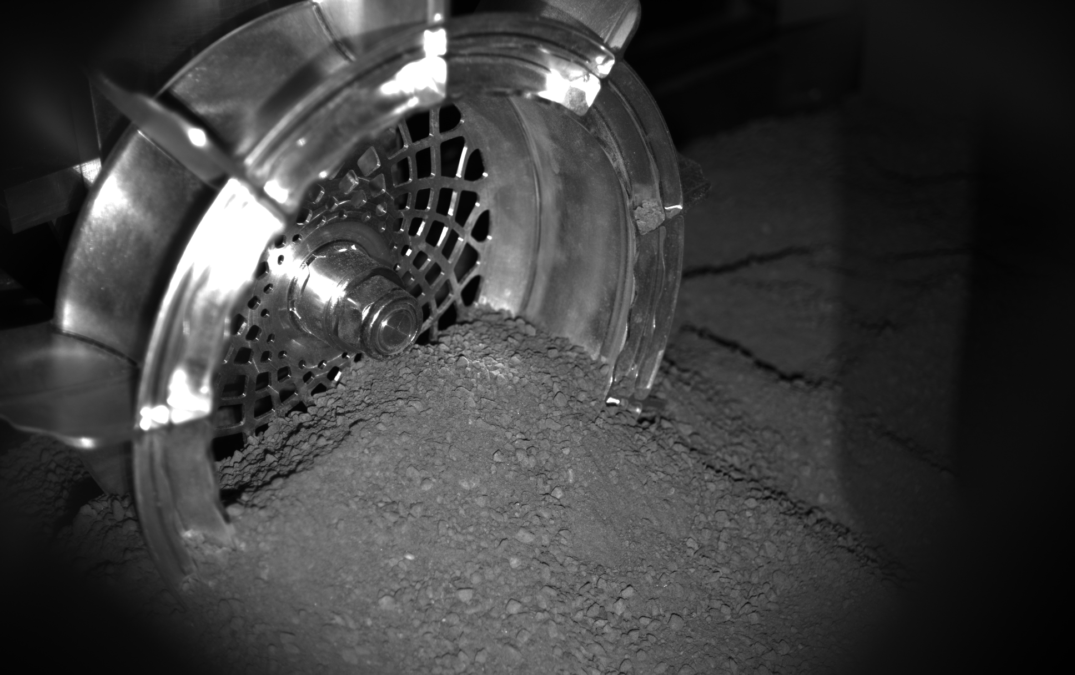
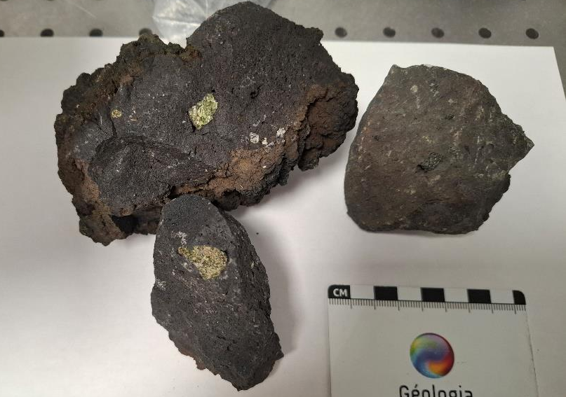
FUTURE WORK
WHEEL DETECTION
Implement sinkage calculation
Validate rear WheelCam detection
Improve performance on front WheelCam
SPECTROMETRY
Obtaining values of reflectance using a calibrating panel
Experimental study of real materials: solid blocks and eventually powdered.
Reverse recognition algorithm will be improved
Notes:
Paloma. Conclusions
Brightness seems to a valid proxy for reflectance trends under controlled conditions
The simplified colored paper model was an effect initial step
The infrared LED introduces limitations in our correlations, since the camera is not very sensitive at this wavelength. Spectral sensitivity and calibrations assumptions will be corrected and improved
For this mode, reverse recognition is limited do to the similarity of the trends of the papers. Paloma. Future Work
Expanding for real materials
Computing actual values of reflectance using a calibrating panel
Sensitivity of the camera****
Florian Conclusions
Florian Future Work
We have an outline of the next steps to implement in the processing pipeline. The ellipse will need to transformed back into a circle using a homography transform, as if the camera observed the wheel perpendicularly. Then, the wheel/regolith interface should be detected. This is where the regolith surface line intersects the homography (it will be clearer in the next images I will show where the wheel is sunk into the regolith). Finally, we can calculate the sinkage as a proportion of the wheel radius by measuring the distance from wheel center to regolith interface.

Slide 22
REFERENCES
Murdoch, N. et al (2025). The WheelCams on the IDEFIX rover.
MMX Exploration Mission. [Online]. Available: https://www.esa.int/Science_Exploration/Space_Science/MMX_factsheet
The Radio Spectrum: Understanding ITU Frequency Bands from VLF to UHF. [Online]. Available: https://www.ariat-tech.com/blog/the-radio-spectrum-understanding-itu-frequency-bands-from-vlf-to-uhf.html
Phobos. [Online]. Available: https://thesolarsystem.fandom.com/wiki/Phobos
Notes:
Paloma. Conclusions
Brightness seems to a valid proxy for reflectance trends under controlled conditions
The simplified colored paper model was an effect initial step
The infrared LED introduces limitations in our correlations, since the camera is not very sensitive at this wavelength. Spectral sensitivity and calibrations assumptions will be corrected and improved
For this mode, reverse recognition is limited do to the similarity of the trends of the papers. Paloma. Future Work
Expanding for real materials
Computing actual values of reflectance using a calibrating panel
Sensitivity of the camera****
Florian Conclusions
Florian Future Work
We have an outline of the next steps to implement in the processing pipeline. The ellipse will need to transformed back into a circle using a homography transform, as if the camera observed the wheel perpendicularly. Then, the wheel/regolith interface should be detected. This is where the regolith surface line intersects the homography (it will be clearer in the next images I will show where the wheel is sunk into the regolith). Finally, we can calculate the sinkage as a proportion of the wheel radius by measuring the distance from wheel center to regolith interface.

Slide 23
Preparing to study the surface of Phobos using IDEFIX WheelCam Images
MASTER in AEROSPACE ENGINEERING
Research Project
Florian Mellab and Paloma Tejero Aranguren
Supervisors:
Dr. Naomi Murdoch
Alice Amsili

Slide 24
Regolith properties from sinkage
Key parameters: Cohesion, internal friction angle, shear strength and stiffness
Modeling approach: Semi-empirical terramechanics models (Bekker and Reece-Wong models)
Important to adapt models to low-gravity conditions
Fit sinkage and slip data
Bearing capacity: independently from rover trench morphology and sinkage analysis
Notes:
Paloma. Conclusions
Brightness seems to a valid proxy for reflectance trends under controlled conditions
The simplified colored paper model was an effect initial step
The infrared LED introduces limitations in our correlations, since the camera is not very sensitive at this wavelength. Spectral sensitivity and calibrations assumptions will be corrected and improved
For this mode, reverse recognition is limited do to the similarity of the trends of the papers. Paloma. Future Work
Expanding for real materials
Computing actual values of reflectance using a calibrating panel
Sensitivity of the camera****
Florian Conclusions
Florian Future Work
We have an outline of the next steps to implement in the processing pipeline. The ellipse will need to transformed back into a circle using a homography transform, as if the camera observed the wheel perpendicularly. Then, the wheel/regolith interface should be detected. This is where the regolith surface line intersects the homography (it will be clearer in the next images I will show where the wheel is sunk into the regolith). Finally, we can calculate the sinkage as a proportion of the wheel radius by measuring the distance from wheel center to regolith interface.

Slide 25
Camera sensitivity
Notes:
Paloma. Conclusions
Brightness seems to a valid proxy for reflectance trends under controlled conditions
The simplified colored paper model was an effect initial step
The infrared LED introduces limitations in our correlations, since the camera is not very sensitive at this wavelength. Spectral sensitivity and calibrations assumptions will be corrected and improved
For this mode, reverse recognition is limited do to the similarity of the trends of the papers. Paloma. Future Work
Expanding for real materials
Computing actual values of reflectance using a calibrating panel
Sensitivity of the camera****
Florian Conclusions
Florian Future Work
We have an outline of the next steps to implement in the processing pipeline. The ellipse will need to transformed back into a circle using a homography transform, as if the camera observed the wheel perpendicularly. Then, the wheel/regolith interface should be detected. This is where the regolith surface line intersects the homography (it will be clearer in the next images I will show where the wheel is sunk into the regolith). Finally, we can calculate the sinkage as a proportion of the wheel radius by measuring the distance from wheel center to regolith interface.

Slide 26
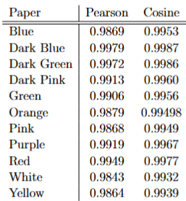
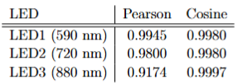
Numerical Results
Notes:
Paloma. Conclusions
Brightness seems to a valid proxy for reflectance trends under controlled conditions
The simplified colored paper model was an effect initial step
The infrared LED introduces limitations in our correlations, since the camera is not very sensitive at this wavelength. Spectral sensitivity and calibrations assumptions will be corrected and improved
For this mode, reverse recognition is limited do to the similarity of the trends of the papers. Paloma. Future Work
Expanding for real materials
Computing actual values of reflectance using a calibrating panel
Sensitivity of the camera****
Florian Conclusions
Florian Future Work
We have an outline of the next steps to implement in the processing pipeline. The ellipse will need to transformed back into a circle using a homography transform, as if the camera observed the wheel perpendicularly. Then, the wheel/regolith interface should be detected. This is where the regolith surface line intersects the homography (it will be clearer in the next images I will show where the wheel is sunk into the regolith). Finally, we can calculate the sinkage as a proportion of the wheel radius by measuring the distance from wheel center to regolith interface.

Slide 27
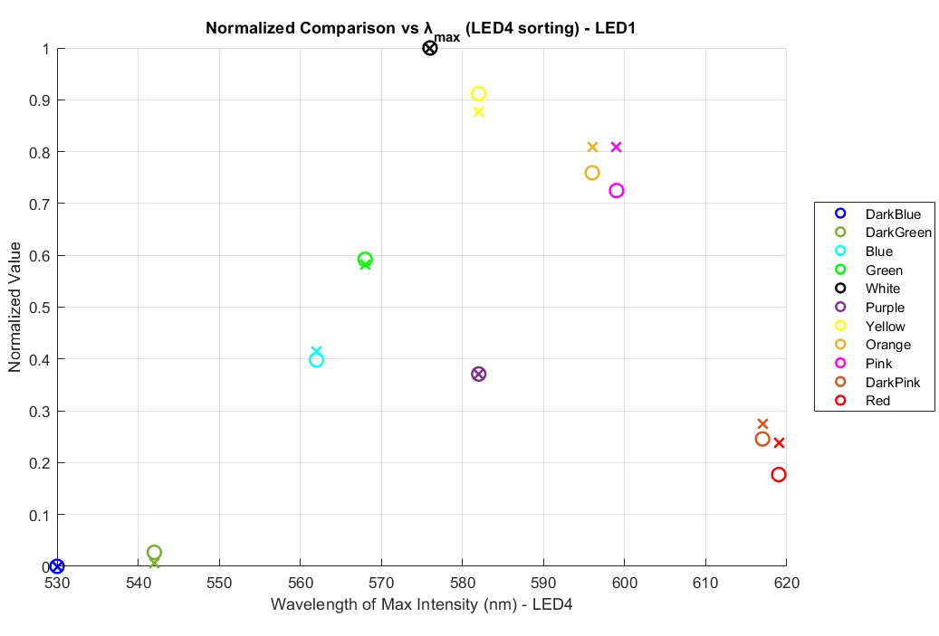
Per LED Analysis
Notes:
Paloma. Conclusions
Brightness seems to a valid proxy for reflectance trends under controlled conditions
The simplified colored paper model was an effect initial step
The infrared LED introduces limitations in our correlations, since the camera is not very sensitive at this wavelength. Spectral sensitivity and calibrations assumptions will be corrected and improved
For this mode, reverse recognition is limited do to the similarity of the trends of the papers. Paloma. Future Work
Expanding for real materials
Computing actual values of reflectance using a calibrating panel
Sensitivity of the camera****
Florian Conclusions
Florian Future Work
We have an outline of the next steps to implement in the processing pipeline. The ellipse will need to transformed back into a circle using a homography transform, as if the camera observed the wheel perpendicularly. Then, the wheel/regolith interface should be detected. This is where the regolith surface line intersects the homography (it will be clearer in the next images I will show where the wheel is sunk into the regolith). Finally, we can calculate the sinkage as a proportion of the wheel radius by measuring the distance from wheel center to regolith interface.

Slide 28
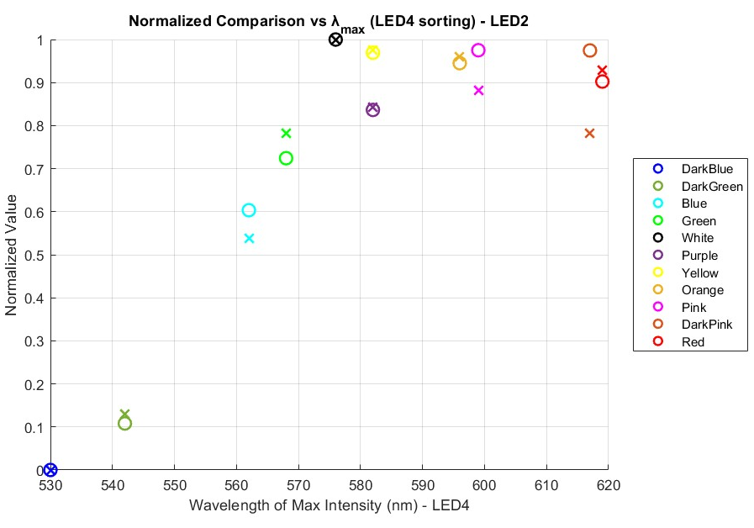
Per LED Analysis
Notes:
Paloma. Conclusions
Brightness seems to a valid proxy for reflectance trends under controlled conditions
The simplified colored paper model was an effect initial step
The infrared LED introduces limitations in our correlations, since the camera is not very sensitive at this wavelength. Spectral sensitivity and calibrations assumptions will be corrected and improved
For this mode, reverse recognition is limited do to the similarity of the trends of the papers. Paloma. Future Work
Expanding for real materials
Computing actual values of reflectance using a calibrating panel
Sensitivity of the camera****
Florian Conclusions
Florian Future Work
We have an outline of the next steps to implement in the processing pipeline. The ellipse will need to transformed back into a circle using a homography transform, as if the camera observed the wheel perpendicularly. Then, the wheel/regolith interface should be detected. This is where the regolith surface line intersects the homography (it will be clearer in the next images I will show where the wheel is sunk into the regolith). Finally, we can calculate the sinkage as a proportion of the wheel radius by measuring the distance from wheel center to regolith interface.

Slide 29
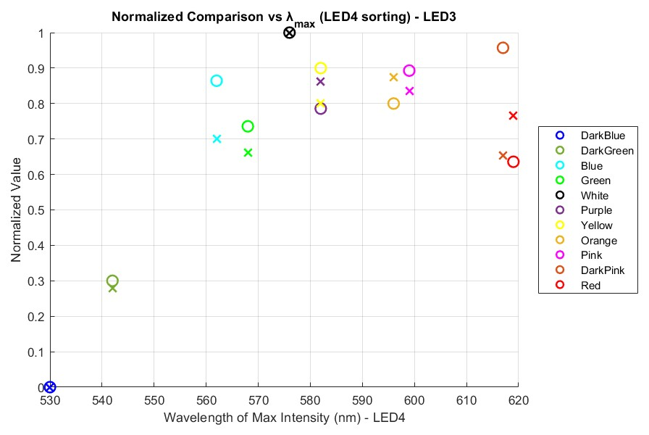
Per LED Analysis
Notes:
Paloma. Conclusions
Brightness seems to a valid proxy for reflectance trends under controlled conditions
The simplified colored paper model was an effect initial step
The infrared LED introduces limitations in our correlations, since the camera is not very sensitive at this wavelength. Spectral sensitivity and calibrations assumptions will be corrected and improved
For this mode, reverse recognition is limited do to the similarity of the trends of the papers. Paloma. Future Work
Expanding for real materials
Computing actual values of reflectance using a calibrating panel
Sensitivity of the camera****
Florian Conclusions
Florian Future Work
We have an outline of the next steps to implement in the processing pipeline. The ellipse will need to transformed back into a circle using a homography transform, as if the camera observed the wheel perpendicularly. Then, the wheel/regolith interface should be detected. This is where the regolith surface line intersects the homography (it will be clearer in the next images I will show where the wheel is sunk into the regolith). Finally, we can calculate the sinkage as a proportion of the wheel radius by measuring the distance from wheel center to regolith interface.

Slide 30
Assumptions
Each LED was assumed to emit light at a single narrow wavelength, despite its known slight variation.
The sensitivity factor of the camera was assumed to be constant for each LED wavelength and assumed to have been corrected in the cameras calibration through the spectral response values provided by the manufacturer.
Assumed that the selected point, identified by the spectrometer's laser receives approximately equal and sufficient illumination from all LEDs.
Main assumption is that there is a linear relationship between image brightness and material reflectance. This is reasonable for our simplified model, but it may not hold in more complex or uncontrolled conditions.
Notes:
Each LED was assumed to emit light at a single narrow wavelength, despite its known slight variation. This allows for a simplified analysis, though it introduces inaccuracies in the spectrometer measurements, where an offset at the peak position was observed at each wavelength.
The sensitivity factor of the camera was assumed to be constant for each LED wavelength and assumed to have been corrected in the cameras calibration through the spectral response values provided by the manufacturer. This assumption will be verified once the calibration of our measurements is made.
Assumed that the selected point, identified by the spectrometer's laser receives approximately equal and sufficient illumination from all LEDs. The angular response of the camera was not explicitly considered, based on the assumption that it would not significantly affect the behavior of the results under the simplified setup. Note that the difference in optics as explained in \autoref{subsec:Testbed} between the WheelCams on IDEFIX and the testbed WheelCams will be substantial, and will have to be considered when the complexity of the model evolves to a proxy of our Phobos environment.
Main assumption is that there is a linear relationship between image brightness and material reflectance. This is reasonable for our simplified model, but it may not hold in more complex or uncontrolled conditions.

Slide 31
Limitations
The samples' reduced reflectance at longer wavelengths, especially under the 880 nm infrared LED, affected the possibility of accurately measure brightness values.
Because the samples consisted of smooth colored paper, only a single region of interest was analyzed for each one. Reasonable for homogeneous surfaces.
Absence of a calibrated reflectance measurement limited the possibility of absolute material identification.
Finally, the number of data points per sample is inherently limited to three (one per LED), which constrains the information obtained and hinders the ability to reliably identify correlations between trends.
Notes:
Each LED was assumed to emit light at a single narrow wavelength, despite its known slight variation. This allows for a simplified analysis, though it introduces inaccuracies in the spectrometer measurements, where an offset at the peak position was observed at each wavelength.
The sensitivity factor of the camera was assumed to be constant for each LED wavelength and assumed to have been corrected in the cameras calibration through the spectral response values provided by the manufacturer. This assumption will be verified once the calibration of our measurements is made.
Assumed that the selected point, identified by the spectrometer's laser receives approximately equal and sufficient illumination from all LEDs. The angular response of the camera was not explicitly considered, based on the assumption that it would not significantly affect the behavior of the results under the simplified setup. Note that the difference in optics as explained in \autoref{subsec:Testbed} between the WheelCams on IDEFIX and the testbed WheelCams will be substantial, and will have to be considered when the complexity of the model evolves to a proxy of our Phobos environment.
Main assumption is that there is a linear relationship between image brightness and material reflectance. This is reasonable for our simplified model, but it may not hold in more complex or uncontrolled conditions.

